Slide 1
Build 2015 Migration

Slide 2
Key Changes for 2015
XAML files have been replaced by an extensible scripting system
Powershell and\or Node.JS driven
Click and Drag build workflow system in web client
Very limited access from within Visual Studio.
A dedicated Release Management suite which teams will have access to for deployments
Build Controllers have been replaced with Agent Pools\Queues

Slide 3
Key Changes by the Build Team
CI will remain the same
Packaging and Deployment have been separated.
Each team will now have Package Builds which supply artefacts to their Releases

Slide 4
Build

Slide 5
Continuous Integration
The Continuous Integration (CI) build is made of the following basic steps
Update AssemblyInfo files with version information
Build Solutions
Unit Testing
Publish Symbols
Publish Drop to File Share
Delete Build Directory

Slide 6
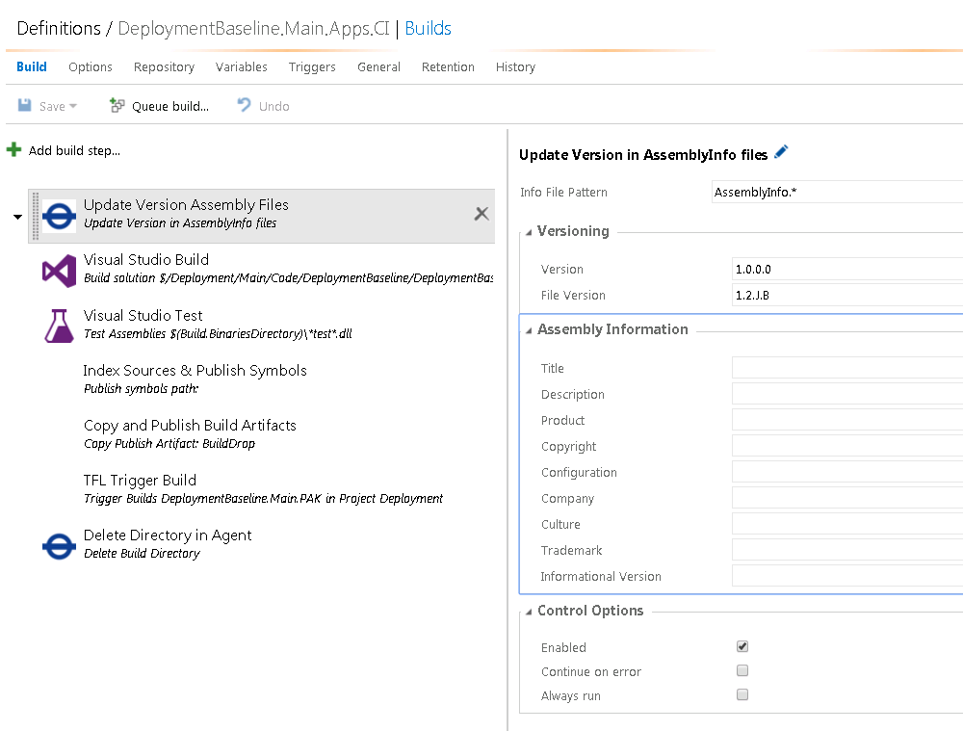
Continuous Integration – Versioning Assemblies
Updates the details in Assembly Information files that match the given pattern
Step Fields
Info File Pattern – string pattern of file names that require updating
Version – What version number to use
File Version – What file version number to use
Title, Description, Product, Copyright, Configuration, Company, Culture, Trademark and Informational Version – These are string based values that can be updated during the build to add extra dynamic information to assembly

Slide 7
Continuous Integration – Versioning Assemblies
Available Pattern Matches include
TPROJ – The name of the Team Project the build is under
REQBY – Who requested the build to be run
BNAME – The name of the Build Definition
UTIME – Universal Time
LDATE – Long Date String
SDATE – Short Date String
STIME – Short Time String
BNUM – The current Build Number
YYYY – The year in four digit format
YY – the year in two digit format
M or MM – The month
D or DD – The day of the month
J – Juliet Date Format
B – Current Build Revision

Slide 8
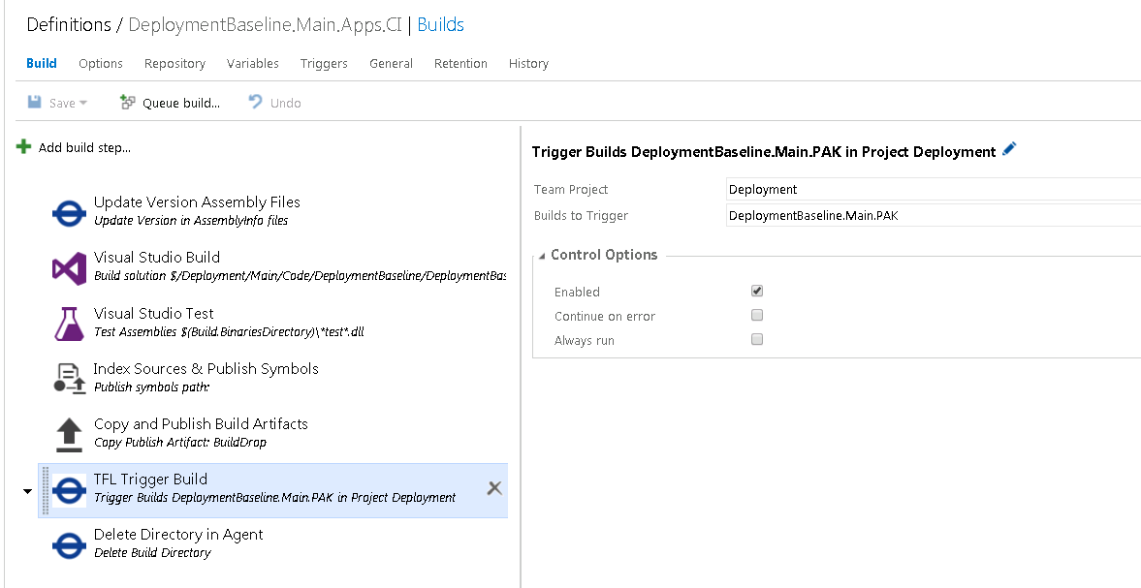
Continuous Integration – Trigger Build
This steps allows user to queue one or more builds from a single team project
Build Step Fields
Team Project – The name of the TFS Team Project the build to be triggered is in
Builds to Trigger – A CSV list of Build Definitions to trigger.

Slide 9
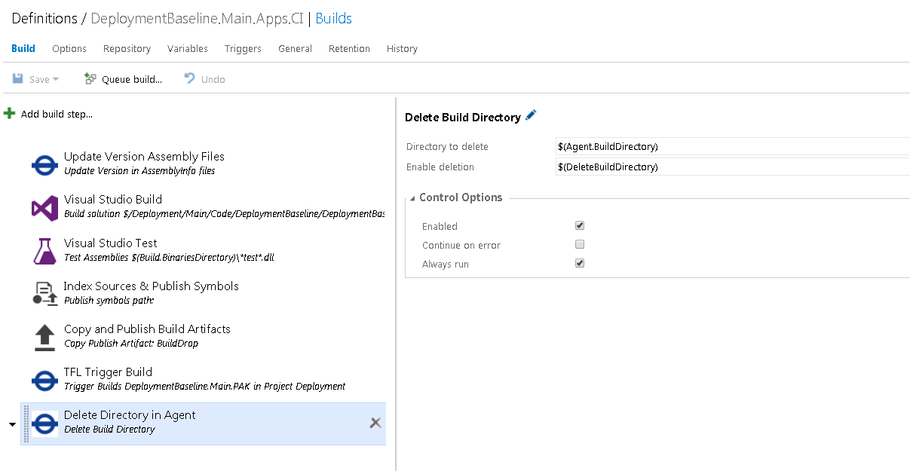
Continuous Integration – Delete Directory
This step will delete the given directory
Build Step Fields
Directory to Delete
Enable Deletion – True or False operator to switch on or off the deletion with out disabling the step.

Slide 10
Packaging
The packaging build is made of the following basic steps
Delete Old Directories
Build Deployment Solutions
Build Post Deployment Tests
Build Functional Tests (Optional)
Import Partition Build (1 step per build to import)
Pre Deployment Validation (1 step per package)
Package (1 Step per package)
Copy Post Deployment Test settings and config
Publish Packages
Publish Test
Delete Build Directory

Slide 11
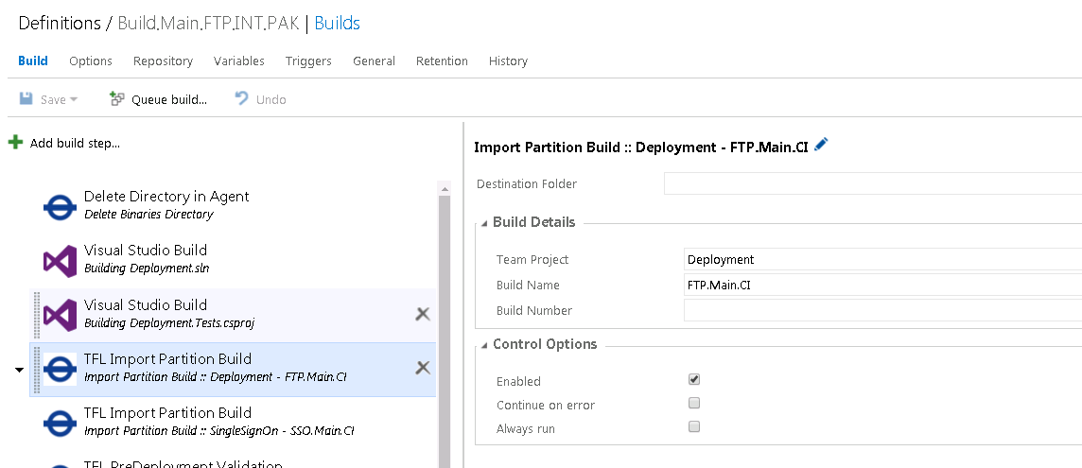
Packaging – Import Partition Build
This build step will copy across the build artefacts with build located.
Build Step Fields
Destination Folder – If blank BuildDrops will be copied into the Binaries. The value provided Builds it’s path from the binaries folder
Team Project – The TFS project of the Build, we want to import is in.
Build Name – The Build Definition Name to be imported
Build Number – If blank the step will retrieve the latest green build. Else provided a specific build number

Slide 12
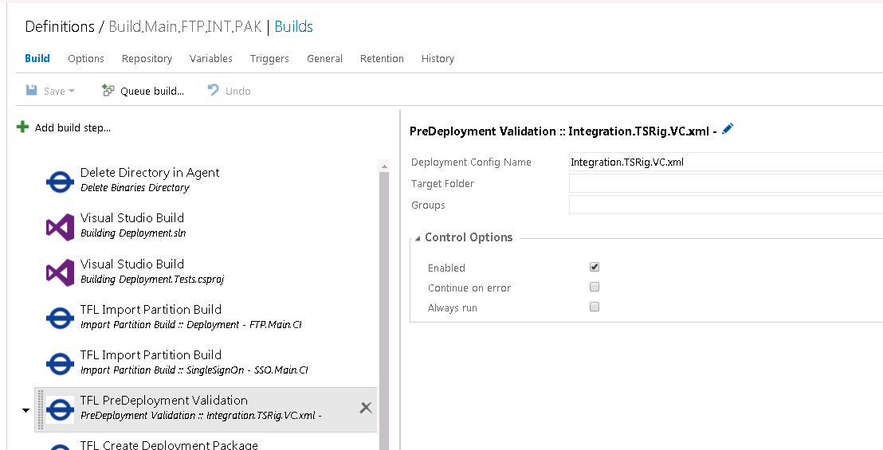
Packaging – Pre Deployment Validation
This build validates that given directory has all the requisite artefacts to create the package from the given deployment configuration.
Build Step Fields
Deployment Config Name – The name of Deployment Config to be used for packaging
Target Folder – If blanket will assume everything required is in the binaries directory in the Agent. Otherwise it will go to the relative path supplied to look for artefacts.
Groups – Will validate based the Comma Seperated list of groups. If blank will not use any groups.

Slide 13
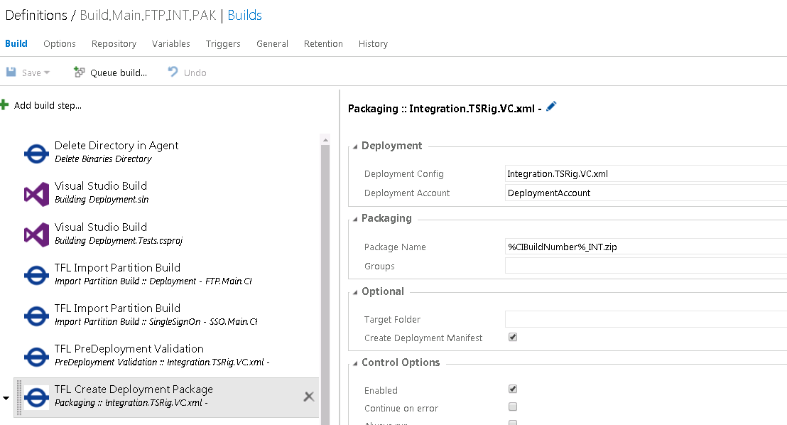
Packaging – Create Package
This step will create the deployment zip ready to be delivered to an environment
Build Step Fields
Deployment Config – The name of the Deployment Configuration file to run packaging against
The name of account declared in the service accounts file which will run the deployment
Package Name – What to name your package zip file. If the field contains the following they will be transformed
%DeploymentBuildNumber% - Will substitute this with the current build number
%CIBuildNumber% - Will substitute this with the number of the first imported build
Groups – What groups to use during packaging, multiple groups provided by a comma separated list
Target Folder – If blank will assume everything is binaries folder, else builds a relative path from that directory.
Create Deployment Manifest – Boolean flag on whether to create a manifest file. You must enable this for packages to be automatically deployed.

Slide 14
Packaging – Deployment Manifest
With the new release system, we required some way of telling a release what packages were being deployed, where they are to be deployed, by who and how.
To facilitate this we output a manifest xml file containing this information. The packaging step will automatically create and update this file if enabled.
The manifest has the following information. <Deployments> <Deployment> <Package Name=“PackageName” Config=“DeployConfigName” Environment=“EnvironmentName” Groups=“CSVGroupList” /> <DeploymentServer Name=“JumpServerName” ExternalIp=“ExtenralIP” /> <DeploymentAccount Name=“DeploymentAccountName” Password=“EncryptedPassword” /> </Deployment> <DeploymentTool Version=“DeploymentToolNuGetVersion” /> </Deployments>

Slide 15
Release

Slide 16
Release Definition vs Environment Definition
The Release module in TFS adds some new concepts to TFS. These being Release and Environment Definitons.
A Release Definition defines what Environments to be deployed to, what artefacts to deploy, when to schedule or trigger a release and common release variables
A Release definition can contain multiple Environment Definitions
An Environment Definition defines what the deployment steps are, what approvals are required, when to deploy to that environment once a release is created and environment specific release variables

Slide 17
Environment Variables vs Release Variables
Release Variables are available to all environments during their retrospective releases
Environment Variables are specific to their given environment. Environments can have the same Variable but differing values.
They are both accessible in the same way in Build Steps or Scripts

Slide 18
Release Triggers
Release Triggers
Manual
Continuous
Everytime a new artefact version is available
Scheduled

Slide 19
Environment Triggers
Environment Triggers
Manual
After Release Creation
After Successful Deployment on another Environment
Environment Trigger Options
Multiple Release Simultaenously
One Deployment at a time
Deploy All – sequentially
Deploy latest

Slide 20
Approvals
You can define Specific Users to pre and post approve a deployment to an environment.
The deployment will held in place until the approval is provided
Email alerts can be generated for approvals.

Slide 21
Basic TFL Deployment
Validate Release Setup
Setup Environment
Execute Deployment
Setup Post Deployment Testing
Post Deployment Test
Functional Tests (Optional)
Deployment Logs copied to Build Share
Delete Release Directory on Release Agent

Slide 22
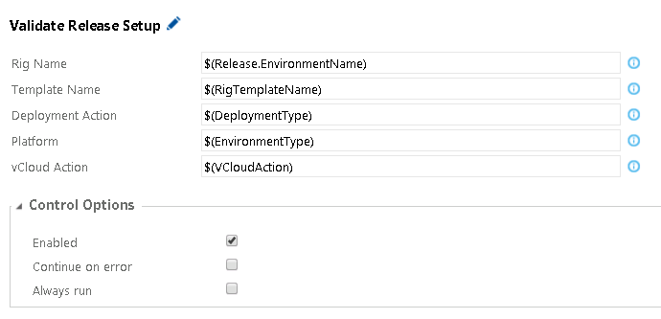
Release – Validate Setup
This step validates that the current deployment setup will be able to work, and detect any setup errors early
Release Step Fields
Rig Name – If using vCloud the name of the Rig
Template Name – If using vCloud the name of the baseline template
Deployment Action – Are we doing a Deploy, DeployAndTest or Test
Platform – Are we using vCloud or CurrentDomain
vCloud Action – If using vCloud are we doing a RefreshRig, ForceRigRefresh, CreateRig or DoNothing

Slide 23
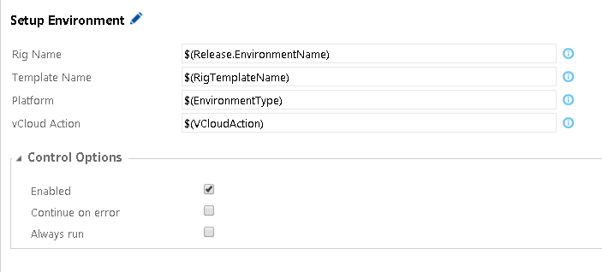
Release – Setup Environment
This step does the Environment setup. If we are using a CurrentDomain environment this step announce that is skipping and continue into the deployment
Release Step Fields
Rig Name – If using vCloud the Name of the Rig being used
Template name – If using vCloud the name of the baseline template being used
Platform – vCloud or CurrentDomain
vCloudAction – if using vCloud are we doing, a RefreshRig, ForceRigRefresh, CreateRig or DoNothing

Slide 24
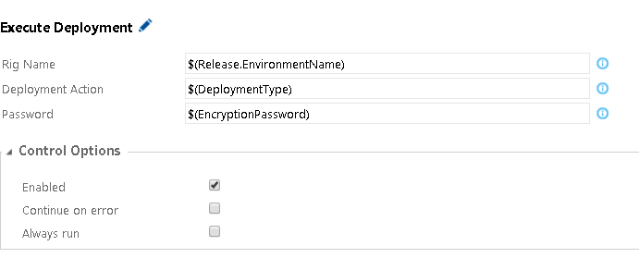
Release – Execute Deployment
This step actually does the Deployment. It iterates through the Deployment Manifest, deploying each package in turn
Release Step Fields
Rig Name - If using the vCloud the name of the rig to deploy to.
Deployment Action – What type of Release. If we doing a Deploy or DeployAndTest the step will execute fully, If we doing a test the step will skip over.
Password – The password to decrypt the service accounts files.

Slide 25
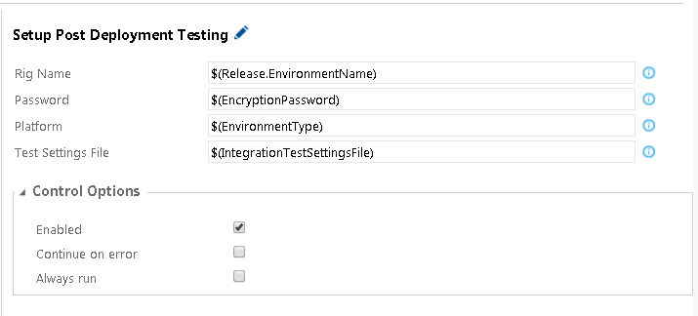
To be able to run post deploy testing we have an app.config file which needs to be updated with dynamic information, this step does that update
Release Step Fields
Rig Name – If using vCloud the name of rig to test
Password – the password used to decrypt the service accounts file
Platform – Are we testing vCloud or CurrentDomain
Test Settings File – What is the name of the app.config to be updated

Slide 26
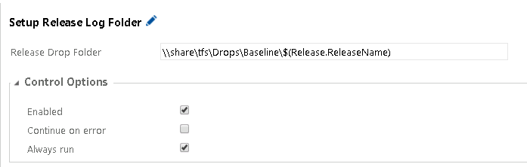
Release – Setup Log Folder
This step sets up output folder for the deployment logs. It archives previous attempts and clears the way for new logs to be copied across
Release Step Fields
Release Drop Folder – Where the deployment logs are going to outputted to.

